Slide 1

Intro Project
DONE BY: Baygeldiev Samat/bekmurzaev elmir

Slide 2
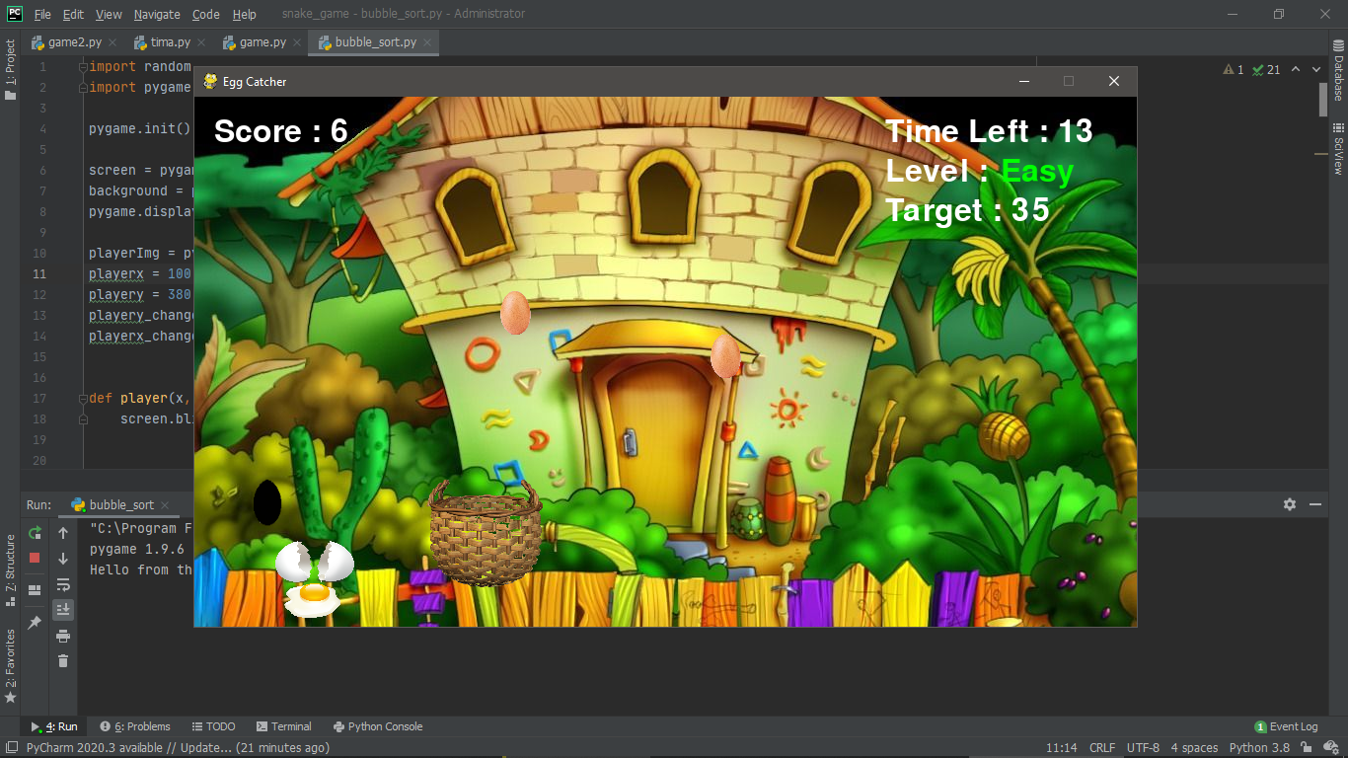
Egg catcher
This is the simple game “Egg catcher” based on python.
Rules:
1. you need to collect white and yellow eggs to bucket in limited time 30 seconds.
2. you need to dodge from black eggs. If you catch the black egg, the game will over.

Slide 3
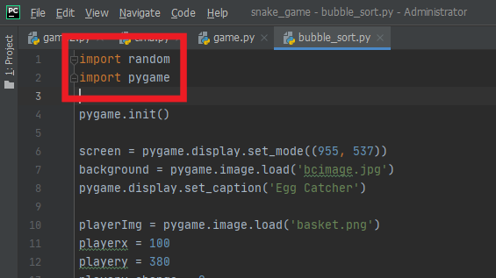
Libraries
We used just two libraries:
1. Random
2. Pygame

Slide 4
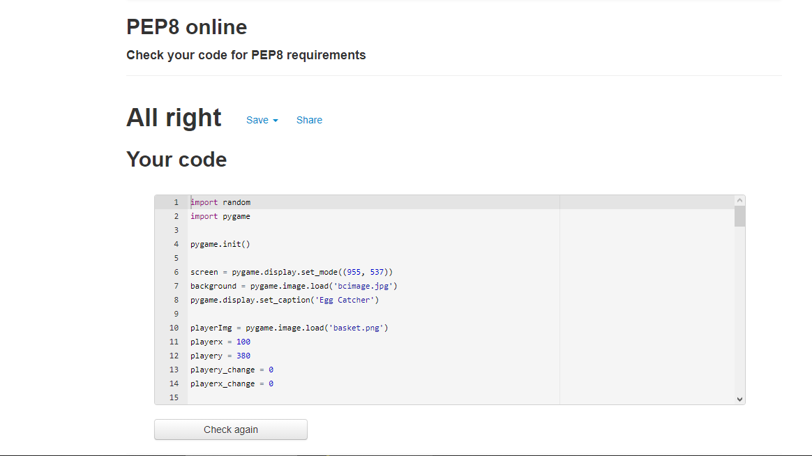
Design
Checked by : http://pep8online.com

